Slide 1
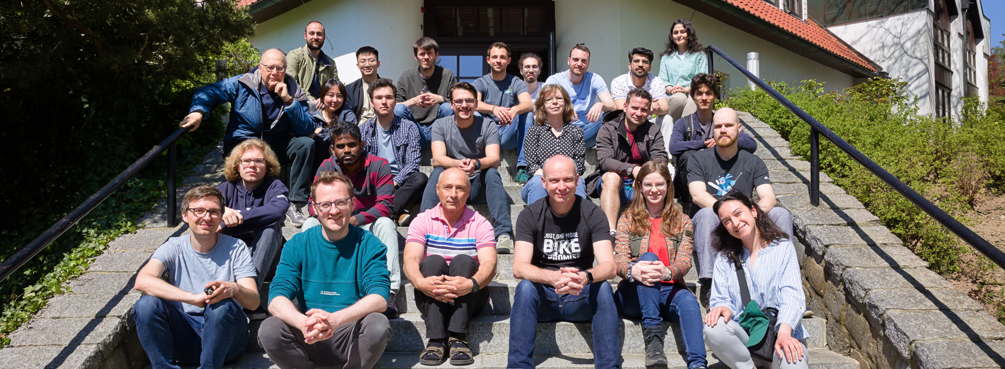
Tiny CNN with microfluidic pipes
Jorge Torres Gómez | Telecommunication Networks

Slide 2
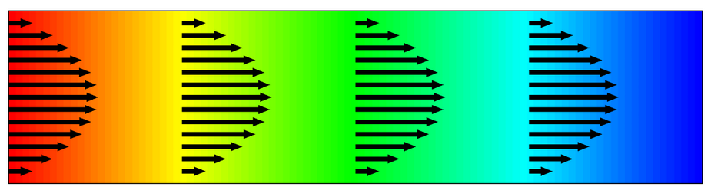

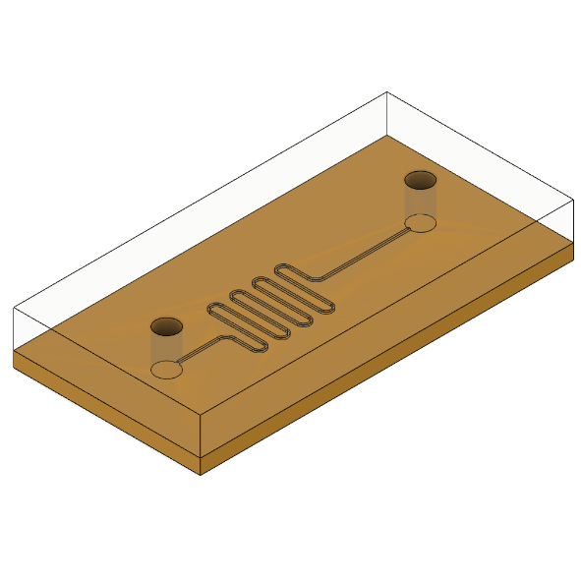
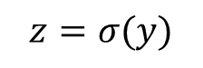
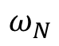
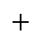
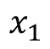

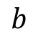
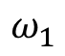
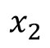
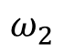
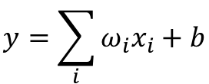
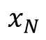
Bio-Computing
Single Neuron Scheme
Digital Computing
Chemical Reaction Networks
DSP
Microfluidic Chips
$$b$$
Activation
Function
$$x_{1}$$
$$ω_{N}$$
$$y=\sum_{i}{ω_{i}x_{i}}+b$$
$$x_{2}$$
$$ω_{2}$$
$$+$$
$$z=σ(y)$$
$$⋯$$
$$x_{N}$$
$$ω_{1}$$
Transport of Diluted Species
Chemical
Reaction
[1] A. O. Bicen and I. F. Akyildiz, “System-Theoretic Analysis and Least-Squares Design of Microfluidic Channels for Flow-Induced Molecular Communication,” IEEE Transactions on Signal Processing, vol. 61, no. 20, pp. 5000–5013, Oct. 2013, doi: 10.1109/TSP.2013.2274959.
Microfluidic Circuit
2

Slide 3
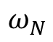
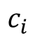
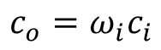
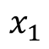
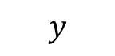
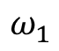
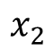
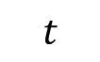
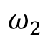
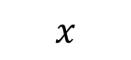
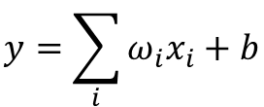
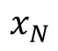
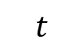
Concept
Single Neuron Scheme
Digital Computing
Chemical Reaction Networks
DSP
Microfluidic Chips
$$b$$
Activation
Function
$$x_{1}$$
$$ω_{N}$$
$$y=\sum_{i}{ω_{i}x_{i}}+b$$
$$x_{2}$$
$$ω_{2}$$
$$+$$
$$z=σ(y)$$
$$⋯$$
$$x_{N}$$
$$ω_{1}$$
$$y$$
Transport of Diluted Species
Inlet
Outlet
$$x$$
$$c_{i}$$
$$c_{o}=ω_{i}c_{i}$$
$$t$$
$$t$$
3

Slide 4
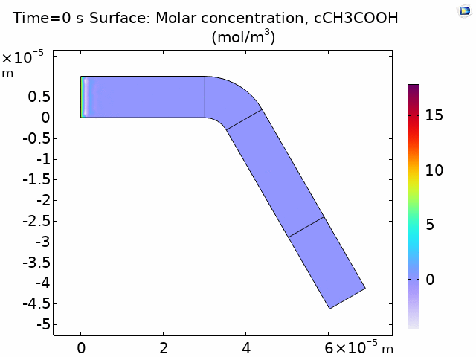

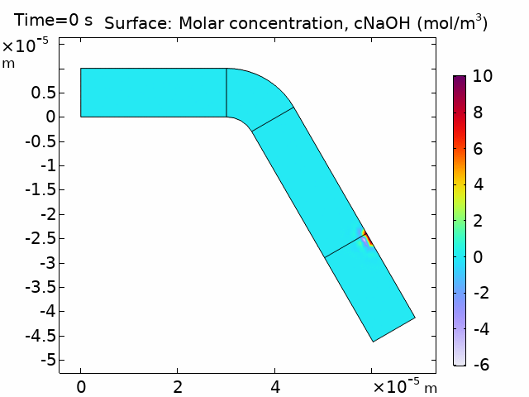

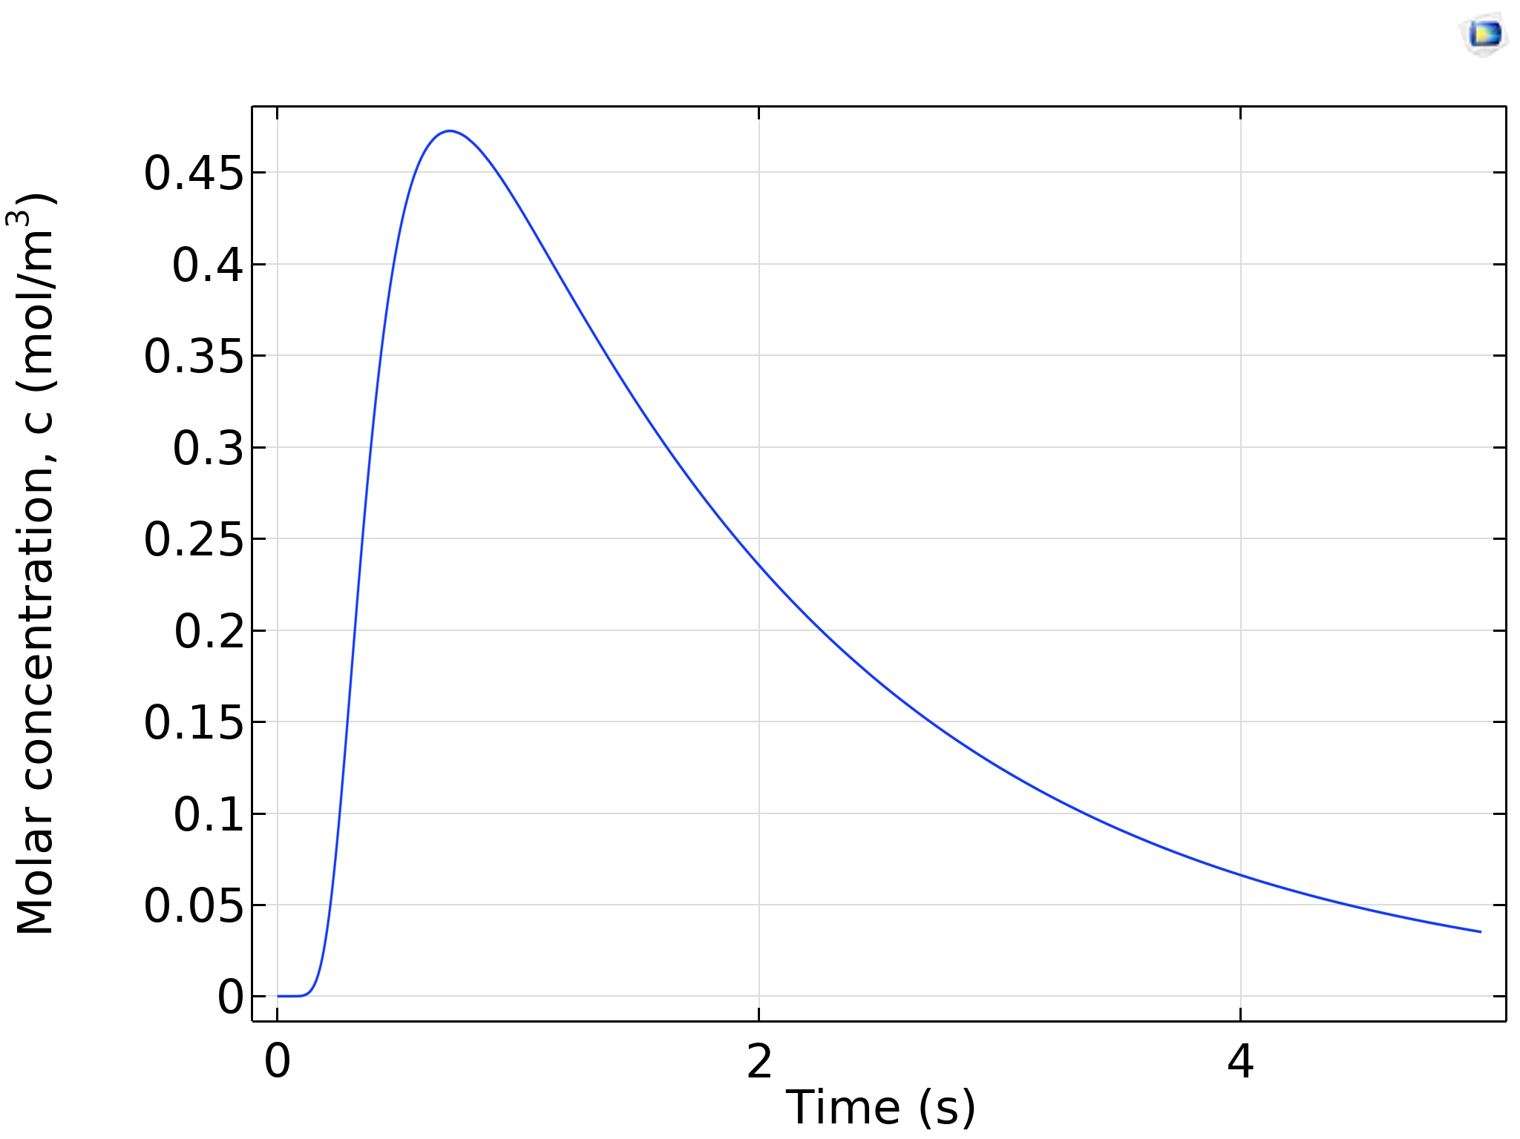
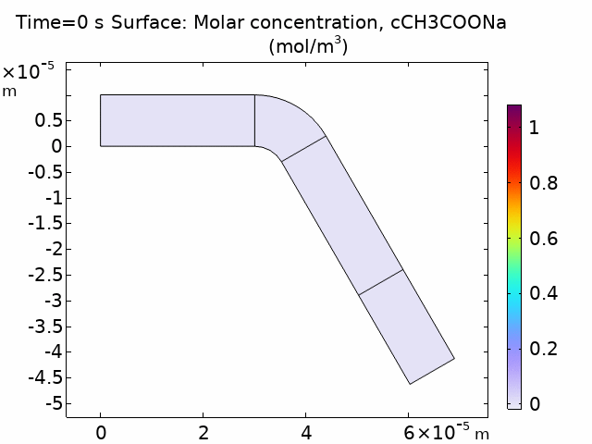
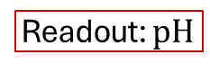
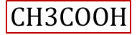
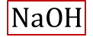
Concept
Activation
Function
$$NaOH$$
$$CH3COOH$$
$$NaOH+CH3COOH →CH3COONa+H2O$$
Readout: $pH$
4

Slide 5

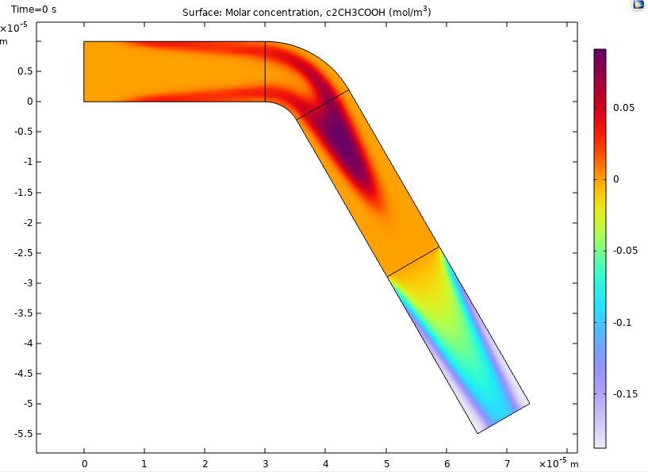


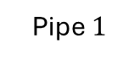
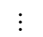
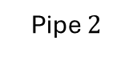
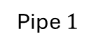
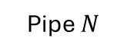
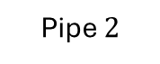
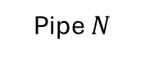
Concept
Single Neuron Scheme
Pipe $N$
$$⋯$$
Pipe $2$
Inlets
Inlet B
Pipe $1$
Outlet
Chemical Reactor
Combiner
CNN-like Scheme
Pipe $N$
$$⋯$$
$$⋯$$
Inlet B
Pipe $2$
Inlet A
Outlet
Pipe $1$
Chemical Reactor
Splitter
Combiner
5

Slide 6

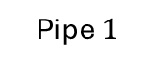
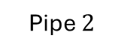
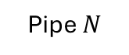
glucose
concentration
Single Neuron Scheme
Pipe $N$
$$⋯$$
Pipe $2$
Inlets
Inlet B
Pipe $1$
Outlet
Chemical Reactor
Combiner
time
serial-to-parallel
converter

Slide 7
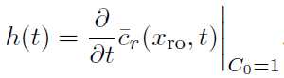
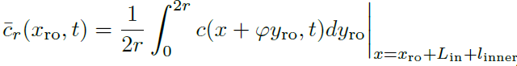
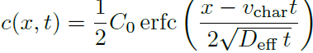
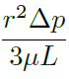
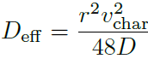
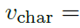




















Analysis
$$y$$
$$y_{ro}$$
Derivative of the Step-response
$$c(x_{0},t)$$
$$r_{out}$$
$$c(x_{1},t)$$
$$r_{in}$$
$$c(x_{2},t)$$
$$x$$
(1)
$$l$$
$$φ$$
$$c_{r}(x_{ro},t)$$
(2)
O
$$x_{ro}$$
$${\overline{c}}_{r}(x_{ro},y_{ro},t)$$
(3)
$$y$$
$$c(x_{0},t)$$
$$c(x_{1},t)$$
$$c(x_{2},t)$$
$$l$$
(4)
(5)
$$x$$
(6)
7

Slide 8














Analysis
$$y$$
$$y_{ro}$$
$$r_{in}$$
$$r_{out}$$
$$c(x_{1},t)$$
$$c(x_{2},t)$$
$$c(x_{0},t)$$
$$x$$
$$l$$
Derivative of the Step-response
$$φ$$
$$c_{r}(x_{ro},t)$$
O
(1)
$$x_{ro}$$
$$x_{ro}$$
(2)
8

Slide 9








Analysis
$$y$$
$$y_{ro}$$
$$r_{in}$$
$$r_{out}$$
$$c(x_{1},t)$$
$$c(x_{2},t)$$
Derivative of the Step-response
$$x$$
$$c(x_{0},t)$$
$$l$$
$$φ$$
$$c_{r}(x_{ro},t)$$
(1)
O
$$x_{ro}$$
$φ=\frac{π}{3}$ $r=20$ μm
$L=3$ mm $r=20$ μm
$L=3$ mm $φ=\frac{π}{3}$
9

Slide 10







Application
CNN-like Scheme
Pipe $N$
$$⋯$$
500 μm to 1 mm
Inlet B
$$⋯$$
Inlet C
Communication Channel
Pipe $2$
Inlet A
Outlet
Pipe $1$
Outlet
Definitions
Chemical Element.
Fluid element.
Pressure.
Size of pipes.
Design of the electronic components
[1] M. M. Albay, E. Akyol, F. Mirlou, L. Beker, and M. Kuscu, “Low-cost Microfluidic Testbed for Molecular Communications with Integrated Hydrodynamic Gating and Screen-printed Sensors,” Jan. 31, 2025, arXiv: arXiv:2501.19341. doi: 10.48550/arXiv.2501.19341.
10

Slide 11











Application
$3×5$ cm
CNN-like Scheme
Pipe $3$
Transmitter
1mm to 4 mm
Inlet B
$$⋯$$
Pipe $2$
Communication Channel
Inlet C
Inlet A
Outlet B
Pipe $1$
Outlet A
Time to fill-in
$∆t={V_{L}}/{Q_{min}}$
$∆t= {2πr^{2}×{heigth}_{max}}/{Q_{min}}$
Flow max
$Q=0.5−7$ μl/min
Height
$\text{10−}\text{50}$ μm
Width: minimum
$\text{5}\text{0}\text{−500}$ μm
NaOH
$$r=50 \text{μ}\text{m}$$ | $$Q=1.89 \text{μ}\text{l}\text{/}\text{min}$$ | $T_{b}=5$ s | $∆t=635$ ms | $≈12\%$
$$r=100 \text{μ}\text{m}$$ | $Q=6.9$ μl/min | $T_{b}=4$ s | $∆t=410$ ms | $≈10\%$
$$r=250 \text{μ}\text{m}$$ | $Q=2.4$ μl/min | $T_{b}=5$ s | $∆t=1.17$s | $≈30\%$
11

Slide 12





Application
$3×5$ cm
CNN-like Scheme
Pipe $3$
Transmitter
500 μm to 1 mm
Inlet B
$$⋯$$
Pipe $2$
Communication Channel
Inlet C
Inlet A
Outlet B
Pipe $1$
Outlet A
12

Slide 13






















Design 1.0
$$P_{u32}$$
$$P_{b32}$$
$$P_{u22}$$
Pipe $3$
$$⋯$$
$$P_{u31}$$
$$P_{b22}$$
Pipe $2$
$$P_{u0}$$
$$P_{u33}$$
$$P_{u11}$$
$$P_{b31}$$
$$P_{u21}$$
$$P_{b21}$$
$$P_{b23}$$
$$P_{u23}$$
$$P_{b33}$$
Pipe $1$
$$P_{b0}$$
$$P_{b12}$$
$$P_{b13}$$
$$P_{b11}$$
13

Slide 14

Design 1.0
14

Slide 15



















Design 1.1
$$P_{u21}$$
Pipe $2$
$$P_{b22}$$
$$P_{u01}$$
$$P_{u22}$$
$$P_{u0}$$
$$P_{b23}$$
$$P_{b21}$$
$$L_{u1}$$
Pipe $1$
$$P_{b31}$$
$$L_{b1}$$
$$P_{b33}$$
$$P_{b0}$$
$$P_{b01}$$
$$P_{u32}$$
$$P_{b32}$$
Pipe $3$
$$P_{u31}$$
15

Slide 16




Design 2
Pipe $3$
Inlet B
$$⋯$$
Pipe $2$
Pipe $1$
Inlet A
Outlet B
Outlet A
Outlet C
16

Slide 17
Design 3
Chemical Reactor
Inlet B
Inlet C
Inlet A
Outlet B
Outlet A
17

Slide 18




Design 4
CNN-like Scheme
Pipe $3$
Transmitter
Communication Channel
Chemical Reactor
Inlet B
$$⋯$$
Pipe $2$
Inlet C
Pipe $1$
Inlet A
Outlet B
Outlet A
Outlet C
18

Slide 19

Application
Pipe $3$
Inlet B
$$⋯$$
Pipe $2$
Inlet C
Inlet A
Outlet B
Pipe $1$
Outlet A
19

Slide 20
Application
CNN-like Scheme
Pipe $N$
$$⋯$$
500 μm to 1 mm
Inlet B
$$⋯$$
Inlet C
Communication Channel
Pipe $2$
Inlet A
Outlet
Pipe $1$
Outlet
20

Slide 21
Application
$3×5$ cm
CNN-like Scheme
Pipe $3$
Transmitter
500 μm to 1 mm
Inlet B
$$⋯$$
Pipe $2$
Communication Channel
Inlet C
Inlet A
Outlet B
Pipe $1$
Outlet A
21

Slide 22

















Synthesis
Pipe $2$
Pipe $3$
Pipe $3$
Pipe $1$
Inlet B
$$⋯$$
Pipe $2$
Inlet C
Inlet A
Outlet B
Pipe $1$
Outlet A
NaOH
Radius: $r∈50−70$ μm
Pipe $3$
Pipe $2$
Pipe $1$
Pipe $2$
Pipe $3$
Pipe $1$
22

Slide 23








Synthesis
Pipe $2$
Pipe $3$
Pipe $3$
Pipe $1$
Inlet B
$$⋯$$
Pipe $2$
Inlet C
Inlet A
Outlet B
Pipe $1$
Outlet A
NaOH
Radius: $r∈50−70$ μm
Pipe $1$
Pipe $2, L_{1}=16.5$ mm
Pipe $3, L_{1}=16.5 \text{mm}$
23

Slide 24



Synthesis
Pipe $2$
Pipe $3$
Pipe $3$
Pipe $1$
Inlet B
$$⋯$$
Pipe $2$
Inlet C
Inlet A
Outlet B
Pipe $1$
Outlet A
NaOH
Radius: $r∈120−150$ μm
Pipe $1$
Pipe $2$
Pipe $2$
Pipe $3$
Pipe $1$
Pipe $3$
24

Slide 25




Synthesis
Pipe $2$
Pipe $3$
Pipe $3$
Pipe $1$
Inlet B
$$⋯$$
Pipe $2$
Inlet C
Inlet A
Outlet B
Pipe $1$
Outlet A
NaOH
Radius: $r∈100−120$ μm
Pipe $1$
Pipe $2, L_{1}=16.5$ mm
Pipe $3, L_{1}=16.5 \text{mm}$
25

Slide 26














Synthesis
Pipe $2$
Pipe $3$
Pipe $2$
Pipe $1$
Inlet B
$$⋯$$
Pipe $2$
Inlet C
Inlet A
Outlet B
Pipe $1$
Outlet A
NaOH
Radius: $r∈250−270$ μm
Pipe $2$
Pipe $3$
Pipe $2$
Pipe $3$
Pipe $1$
Pipe $1$
26

Slide 27







Synthesis
Pipe $2$
Pipe $3$
Pipe $2$
Pipe $1$
Inlet B
$$⋯$$
Pipe $2$
Inlet C
Inlet A
Outlet B
Pipe $1$
Outlet A
NaOH
Radius: $r∈250−270$ μm
27

Slide 28







Synthesis
Pipe $2$
Pipe $3$
Pipe $2$
Pipe $1$
Inlet B
$$⋯$$
Pipe $2$
Inlet C
Inlet A
Outlet B
Pipe $1$
Outlet A
NaOH
Radius: $r∈250−270$ μm
Pipe $1$
Pipe $2, L_{1}=28.3$ mm
Pipe $3, L_{1}=28.3 \text{mm}$
28

Slide 29













Synthesis
Pipe $3$
Inlet B
$$⋯$$
Pipe $2$
Inlet A
Outlet B
Pipe $1$
Outlet A
Tartrazine
Radius: $r∈250−270$ μm
Pipe $1$
Pipe $2$
Pipe $3$
Pipe $3$
Pipe $2$
Pipe $1$
29

Slide 30






Synthesis
Pipe $2$
Pipe $3$
Pipe $2$
Pipe $1$
Inlet B
$$⋯$$
Pipe $2$
Inlet A
Outlet B
Pipe $1$
Outlet A
Tartrazine
Radius: $r∈100−120$ μm
Pipe $1$
Pipe $2, L_{1}=26.6$ mm
Pipe $3, L_{1}=26.6 \text{mm}$
30

Slide 31









Synthesis
CNN-like Scheme
Pipe $N$
$$⋯$$
$$⋯$$
Inlet B
Pipe $2$
Inlet A
Outlet
Pipe $1$
Chemical Reactor
Splitter
Combiner
Design constraints
(1)
(2)
(3)
31

Slide 32







Synthesis
CNN-like Scheme
Pipe $N$
$$⋯$$
$$⋯$$
Inlet B
Pipe $2$
Inlet A
Outlet
Pipe $1$
Chemical Reactor
Splitter
Combiner
32

Slide 33


Synthesis
CNN-like Scheme
Design constraints
Pipe $N$
(1)
$$⋯$$
$$⋯$$
Inlet B
Pipe $2$
(2)
Inlet A
Outlet
Pipe $1$
Chemical Reactor
Splitter
Combiner
(3)
33

Slide 34


Synthesis
CNN-like Scheme
Design constraints
Pipe $N$
(1)
$$⋯$$
$$⋯$$
Inlet B
Pipe $2$
(2)
Inlet A
Outlet
Pipe $1$
Chemical Reactor
Splitter
Combiner
(3)
34

Slide 35


Synthesis
CNN-like Scheme
Pipe $N$
$$NaOH+CH3COOH →CH3COONa+H2O$$
$$⋯$$
$$⋯$$
Inlet B
Pipe $2$
Inlet A
Outlet
Pipe $1$
Chemical Reactor
Splitter
Combiner
35

Slide 36


Bio-Computing
Digital Computing
Chemical Reaction Networks
DSP
Microfluidic Chips
36

Slide 37





Linear Component: $ω_{i}∙x_{i}$
$$ω_{1}$$
$$ω_{2}$$
37

Slide 38

Bio-Computing
Analog Computing
Wet-Neuromorphic Computing
Chemical Reaction Networks
Compartment Based
Models
Reservoir Computing
J. Perera et al., “Wet-Neuromorphic Computing: A New Paradigm for Biological Artificial Intelligence,” IEEE Intelligent Systems, pp. 1–7, 2025. DOI: 10.1109/mis.2025.3555551.

Slide 39

Bio-Computing
Analog Computing
Wet-Neuromorphic Computing
Chemical Reaction Networks
Compartment Based
Models
Reservoir Computing
J. Perera et al., “Wet-Neuromorphic Computing: A New Paradigm for Biological Artificial Intelligence,” IEEE Intelligent Systems, pp. 1–7, 2025. DOI: 10.1109/mis.2025.3555551.

Slide 40


Bio-Computing
Analog Computing
Wet-Neuromorphic Computing
Chemical Reaction Networks
Compartment Based
Models
Reservoir Computing
J. Perera et al., “Wet-Neuromorphic Computing: A New Paradigm for Biological Artificial Intelligence,” IEEE Intelligent Systems, pp. 1–7, 2025. DOI: 10.1109/mis.2025.3555551.

Slide 41

Bio-Computing
[1] S. Balasubramaniam, S. Somathilaka, S. Sun, A. Ratwatte, and M. Pierobon, “Realizing Molecular Machine Learning Through Communications for Biological AI,” IEEE Nanotechnology Magazine, vol. 17, no. 3, pp. 10–20, Jun. 2023, doi: 10.1109/MNANO.2023.3262099.

Slide 42

Bio-Computing
Digital Computing
Chemical Reaction Networks
DSP
Microfluidic Chips
Analog Computing
Wet-Neuromorphic Computing
Chemical Reaction Networks
Compartment Based Models
Reservoir Computing
$\sim 300$ learnable parameters

Slide 43

Datasets
43

Slide 44
Communicating Smartly at the Nanoscale - Neural Networks Developments in Molecular Communication
Jorge Torres Gómez | Telecommunication Networks

Slide 45
nanoAI Lab: A new research group
Jorge Torres Gómez | Telecommunication Networks

Slide 46



Research groups in our Network
General Purpose AI for IoBNT Applications
Micro-fluidic circuits
Werner Haselmayr
Ozgur Baris Akan
H. Birkan Yilmaz
Functionalized Graphene
Ozgur Baris Akan

Slide 47





Grant programs: National
Discovery Grants
Address higher-risk (higher reward) topics.
Discovery Horizons/Alliance Society
Investigator-initiated individual and team projects.
Interdisciplinary research.
Exploration
Competition-based
Interdisciplinary research.
Promote relevant collaborations across disciplines, professions, and sectors.

Slide 48



Grant programs: International
International
Competition based
Four years funding
Funding for one year to initiate international research collaborations
International Partners:
Turkey (Koc Uni., Bogazici Uni.)
Germany (TU Berlin, TU Dresden, TU Darmstadt, Erlangen)
Norway (Oslo University Hospital)
Sweeden (Uppsala University)
Spain (Polytechnic University of Barcelona)
Italy (University of Milano)
US (Northeastern University, Michigan University, Nebraska)
Join and lead consortium projects among 3 countries at least (EU+Canada)

Slide 49


NanoAI Lab: MOU Network
Deciphering Gene Regulation in Bacteria
Lourdes Pena-Castillo
Computer Science
https://www.cs.mun.ca/~lourdes/public/index.html
Signaling Mechanisms in Cell Survival and Cell Growth
Dr. Brian E. Staveley, Ph.D.
Department of Biology
https://www.mun.ca/biology/bstaveley/
Peptide-Induced Reorganization of Lipid Assemblies
M. R. Morrow
Department of Physics
https://www.physics.mun.ca/~mmorrow/
Hierarchical Materials
Erika Merschrod
Department of Chemistry
https://www.merschrod.group/team.html
Electronic sensor platform

Slide 50
Understanding SeMeCo: Yeast Metabolic Teamwork
Falko Dressler | Telecommunication Networks

